Slide 1



Azure NetApp Files
Azure storage has never been so cool!
Berkshire azure user group

Slide 2
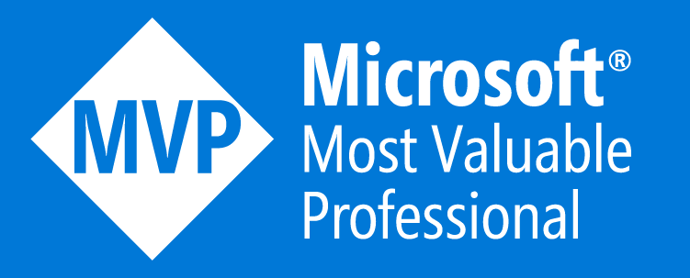




About Me
Worked within the Information Technology industry for more than 20 years​
Cloud Solutions Architect at NetApp in the EMEA Azure Business Group
Focused on Azure, specialising in Azure NetApp Files
Anthony MAshford
anthonymashford
azuretechlab.com
anthonymashford

Slide 3
About Me
Worked within the Information Technology industry for more than 20 years​
Cloud Solutions Architect at NetApp in the EMEA Azure Business Group
Focused on Azure, specialising in Azure NetApp Files
First career
Fisherman
anthonymashford
azuretechlab.com
anthonymashford

Slide 4

About Me
That’s me, there!
Worked within the Information Technology industry for more than 20 years​
Cloud Solutions Architect at NetApp in the EMEA Azure Business Group
Focused on Azure, specialising in Azure NetApp Files
Second career
H.M Royal Marines
anthonymashford
azuretechlab.com
anthonymashford

Slide 5
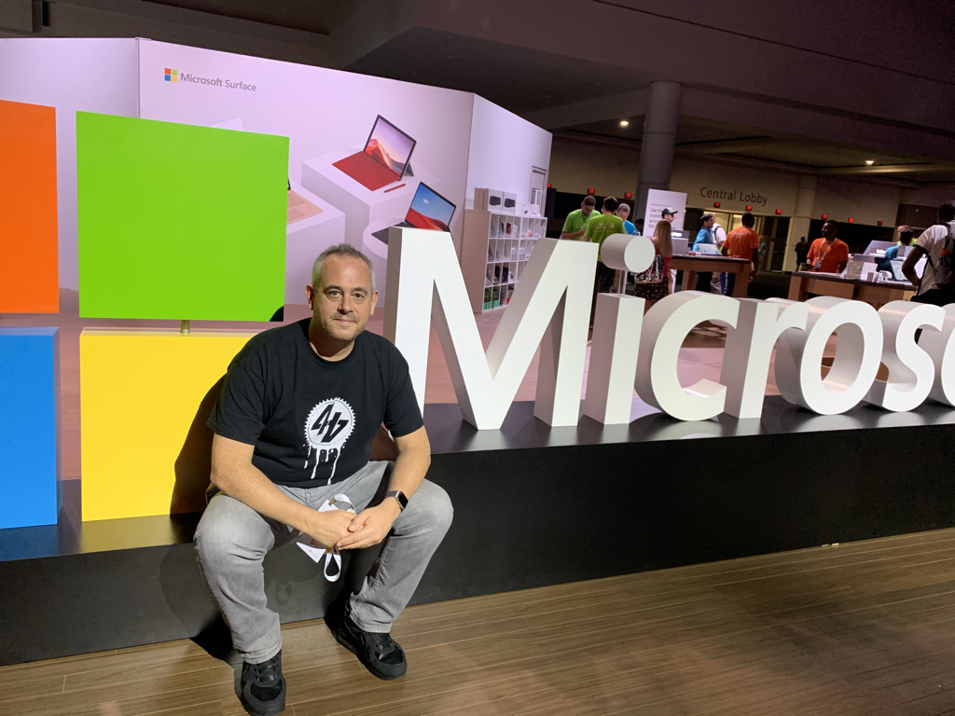
About Me
Worked within the Information Technology industry for more than 20 years​
Cloud Solutions Architect at NetApp in the EMEA Azure Business Group
Focused on Azure, specialising in Azure NetApp Files
Third career
Technology
anthonymashford
azuretechlab.com
anthonymashford

Slide 6

About Me
Worked within the Information Technology industry for more than 20 years​
Cloud Solutions Architect at NetApp in the EMEA Azure Business Group
Focused on Azure, specialising in Azure NetApp Files
Me Having Fun!
anthonymashford
azuretechlab.com
anthonymashford

Slide 7
Agenda
Challenges
Azure Netapp Files
Discuss some of the challenges faced with File storage in Azure.
Overview of the Microsoft Azure NetApp Files service.
Feature Updates
Demo
A look at new features and service enhancements over the past year.
Deploying ANF accounts, capacity pools and volumes

Slide 8

Challenges

Slide 9




Common Challenges
Cost
Test & Dev
Migration
Scale
Cloud services can typically be more expensive to consume
Testing & Development against production data sets can be challenging
Migration of data sets from on-premises to Azure
Scaling of resources to meet demand

Slide 10




Optimise Compute to meet demand
vCPU
Network
vMemory
DISK
This can affect the following:
Performance
Scalability
Costs
Licensing

Slide 11

Azure NetApp Files overview

Slide 12
OVERVIEW
“MICROSOFT AZURE NETAPP FILES IS AN AZURE FIRST-PARTY SERVICE delivered, supported and billed BY MICROSOFT”.

Slide 13


Use cases
Migration (Windows Apps & SQL Server | Linux OSS Apps & Database | SAP on Azure)
Specialized Workloads (HPC | VDI | AVS)
HPC
Generic
O&G
EDA
VDI
Azure Virtual Desktop
Citrix
FSLogix (profile & MSIX App Attach)
Azure VMware Solutions
NFS Datastore
Guest OS mounts
Azure Platform Services (AKS, Azure Batch, …)
…
Azure NetApp Files (Enterprise NAS)

Slide 14
OVERVIEW
Widest choice of file protocols (NFSv3, NFSv4.1, SMB3) in Azure (99.99% SLA)
On-premises-class performance with multiple tiers (Ultra, premium, and standard)
Most advanced enterprise data management (NetApp® Snapshot™ copies, clones, and replication)
Azure consistent experience, support, and billing VIA Azure portal, not marketplace!
Standard
Premium
Ultra
IOPs 1,000 (16K) per 1TiB
--------------------------
Throughput
16MiBps per 1TiB
IOPs 4,000 (16K) per 1TiB
--------------------------
Throughput
64MiBps per 1TiB
IOPs
8,000 (16K) per 1TiB
--------------------------
Throughput
128MiBps per 1TiB
NetApp ONTAP® and flash technology as a fully managed Azure service

Slide 15
Azure Subscription
Azure NetApp Account
US East
Azure NetApp Account West Europe
… up to 10
Azure NetApp Account x
Region x
… up to 10
Capacity Pool 1
Ultra
2 - 1000 TiB
Capacity Pool 2
Premium
2 - 1000 TiB
Capacity Pool N
Standard
2 - 1000 TiB
… up to 25
Up to 25 PiB of Enterprise NAS storage under
a single Azure NetApp Account!
Vol 1
100GiB – 100TiB
Vol 2
100GiB – 100TiB
… up to 500
Vol z
100GiB – 100TiB

Slide 16

Performance
Service level | Throughput
Ultra | 128MiB/s per 1TiB quota
Premium | 64MiB/s per 1TiB quota
Standard | 16MiB/s per 1TiB quota
X
=
Service Level
Volume quota
Performance
Example: 50 TiB premium pool performance
50 x 64 MiB/s = 3.2 GiB/s (all-up)
Volume size 10 TiB
Volume performance 10 x 64 MiB/s = 640 MiB/s

Slide 17
Sizing for Performance – Auto QoS
10 TiB Ultra Capacity Pool Auto QoS (ultra service level = 1280 MiB/s)
1280 MiB/s
Backup
4.5 TiB / 576 MiB/s
Shares
Data
4 TiB / 512 MiB/s
Throughput
Logs
Capacity
10 TiB

Slide 18
Sizing for Performance – Manual QoS
10 TiB Ultra Capacity Pool Manual QoS (ultra service level = 1280 MiB/s)
1280 MiB/s
Backup
4.5 TiB / 256 MiB/s
Shares
Data
4 TiB / 704 MiB/s
Throughput
Select Throughput
Logs
Capacity
10 TiB

Slide 19
Dynamic Volume Shaping - ANF

Slide 20
Azure NetApp Files features

Slide 21
Cross region Replication
Features
Replicate volume to regional pair
Replicate volume to non-regional pair
Replicate to different storage tier
Replication intervals
10 mins
1 hour
1 day
UK South
UK West
Cross region replication
Asynchronous replication across regions
Volume
Volume

Slide 22
Availability zone volume placement
Features
Azure Region
Public Preview
Choose the AZ for the new volume
Create HA deployments
Use Application redundancy
No cross-zone transfer charges (Currently)
Az1
Az2
Choose Availability Zone
Volume
Volume

Slide 23
Cross zone Replication
Features
Azure Region
Public Preview
Replicate volume to regional and non-regional pair
Replicate to different storage tier
Replication intervals
10 mins
1 hour
1 day
Az1
Az2
Cross zone replication
Asynchronous replication across zones
Volume
Volume

Slide 24


Anf backup
Features
Azure Region
Public Preview
Fully managed backup solution
Long term recovery, archive and compliance
Backups can be retored to new ANF volumes within the same account
ANF Account
Cost-optimised
Backup policy
7 Daily
4 Weekly
12 Monthly
Volume
ZRS Storage

Slide 25



AVS & ANF Datastores
Features
Azure Subscription
Enterprise-Class, High-Performance Storage Service
Attaching NFS Datastores as a persistent storage
Extend Storage instead of scaling the clusters
Attaching SMB/NFS User Shares directly to the Virtual Machine
AVS Private Cloud
ANF Datastores
Express Route
Express Route
Gateway
Volume
ANF Volumes

Slide 26
Standard Storage with Cool-Access
Features
Azure Subscription
Public Preview
Transparently tier cold data blocks to ZRS storage
Cool period can be setup from 7 to 183 days
Enabled at the capacity pool level
Meta data remains
Low IO workloads
Huge cost savings
ANF Volume
Cool-Access Tier
Data blocks
ZRS Storage

Slide 27
More features released recently
Standard Network Features
Non Browsable Shares
SMB CA Shares
Cloud Backup for VMs
Double Encryption
Azure Virtual WAN
Access Based Enumeration
Backup Vault
Customer Managed Keys
QoS Volume Move
User Group Quotas

Slide 28

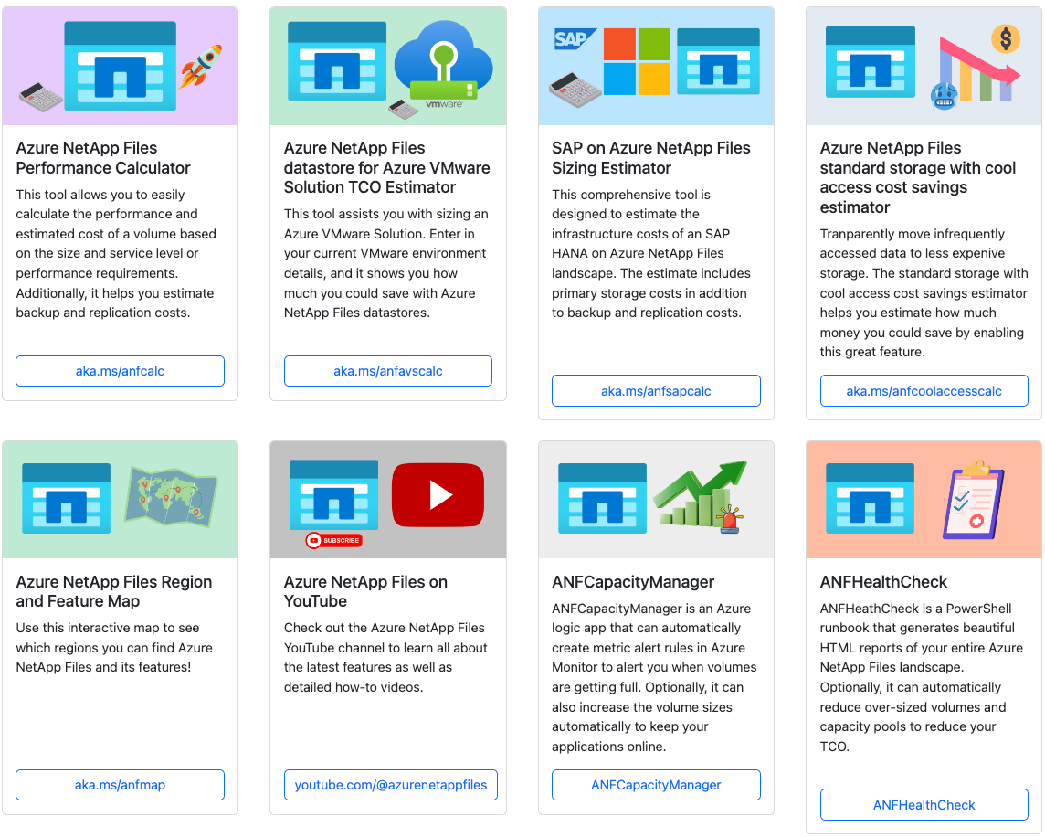
ANF Tools

Slide 29


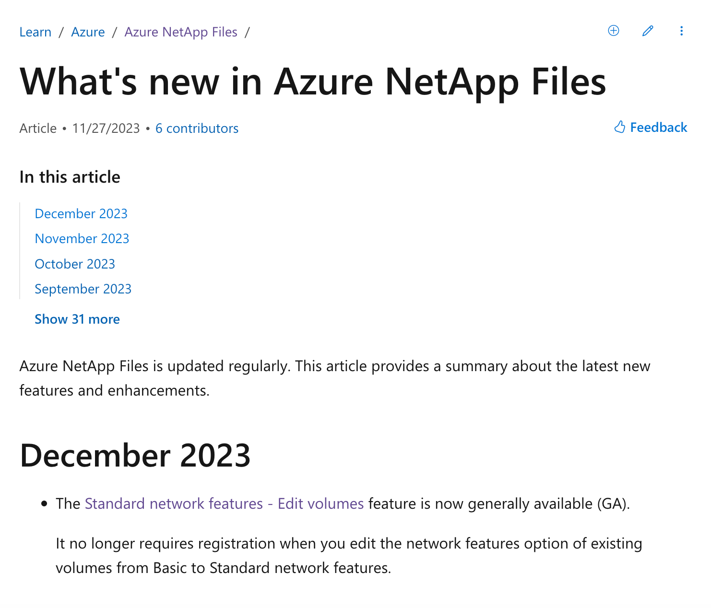
What’s new in ANF
Recent updates to ANF:
Customer Managed Keys (CMK) GA
Standard Network Features – Edit Existing Volumes GA
2 TiB Capacity Pools GA
1 TiB Capacity Pools Public Preview
Azure Metrics Enhancement to Throughput Limit
Volume User/Group Quotas GA
SMB CA Shares now supports MSIX App Attach
ANF Backup Vault Public Preview
Cloud Backup for VMs on AVS/ANF Datastores Public Preview
Double Encryption at Rest Public Preview
Cross Zone Replication Public Preview
Standard Storage with Cool-Access Public Preview

Slide 30

demo
Creating an Azure NetApp Files account
Adding a capacity pool
Creating a Volume
Attaching a Volume to a Virtual Machine

Slide 31




Microsoft Azure NetApp Files
Summary
Let’s you streamline and simplify data migration to Azure by combining new of levels of
Simplicity
Efficiency
Cost
Mobility
Microsoft Azure NetApp Files is a fully managed cloud service

Slide 32

Useful links
https://github.com/anthonymashford/WAUG2023
https://docs.microsoft.com/en-us/azure/azure-netapp-files/whats-new
https://aka.ms/anftools
https://aka.ms/ANF-benchmarks
https://docs.microsoft.com/en-us/azure/azure-netapp-files/azure-netapp-files-solution-architectures

Slide 33


Get Started Today
Login to the Azure Portal
Setup your Microsoft Azure NetApp Files account ​
Add your Capacity Pools
Create your Volumes

Slide 34


Thank you
Connect with me ☺
anthonymashford
azuretechlab.com
anthonymashford

